Slide 1
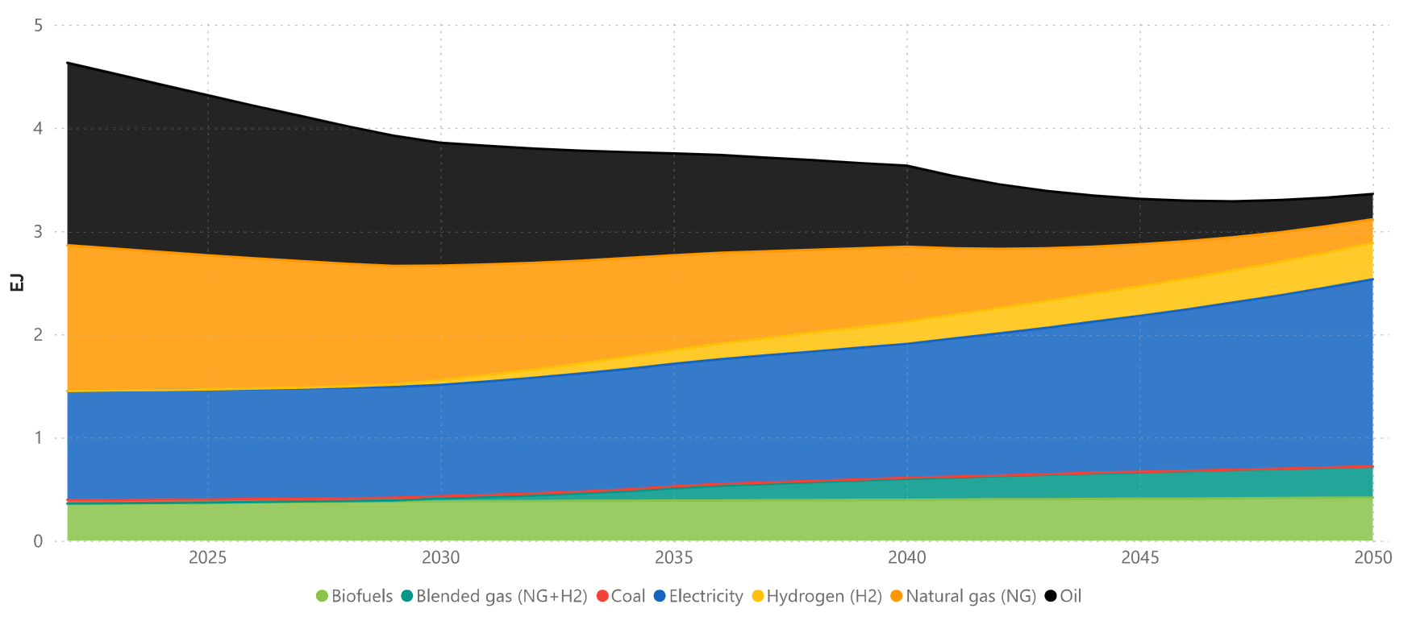
2022

Slide 3
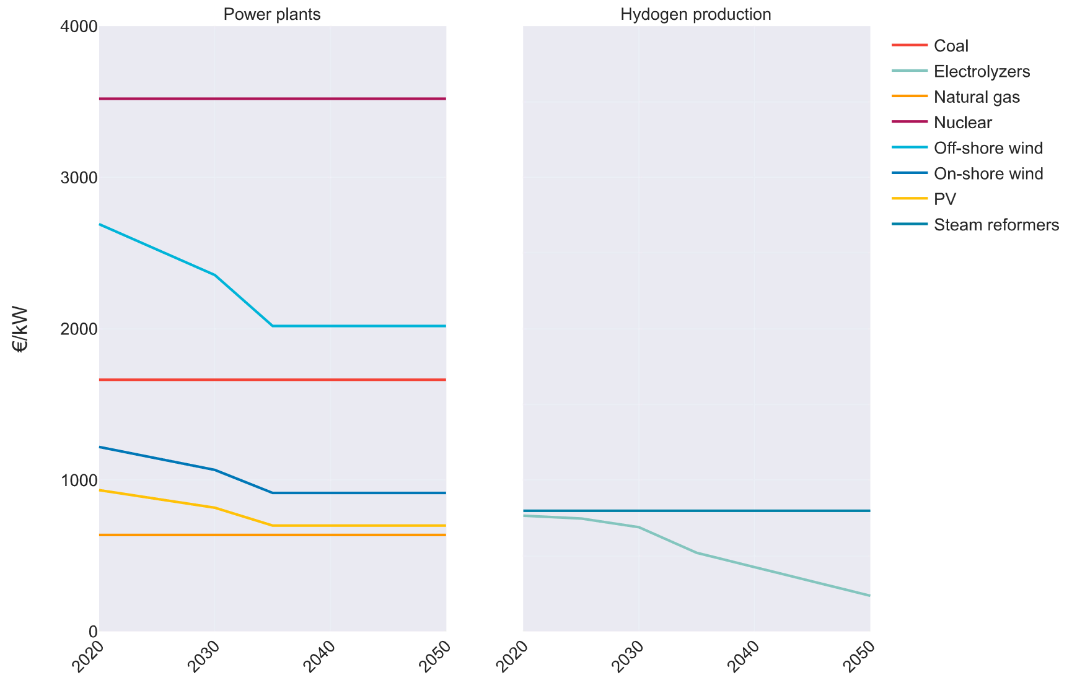
3519
2692
2019
1664
1220
915
934
701
798
765
637
236

Slide 4
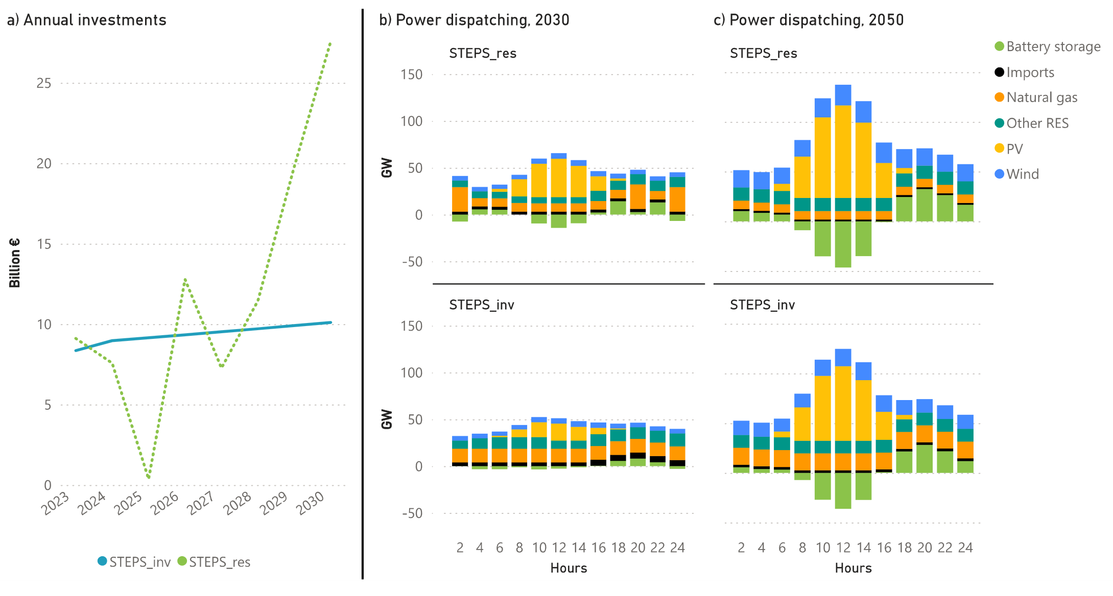

Slide 5
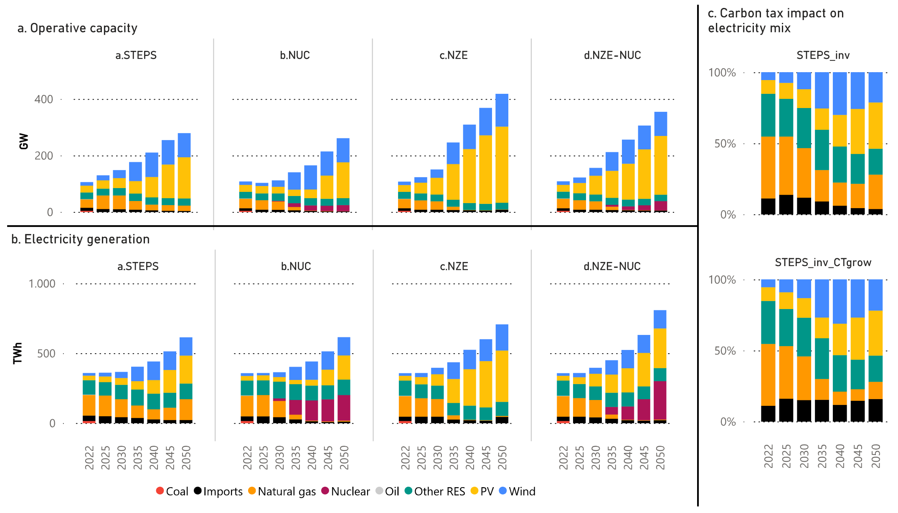
STEPS_inv (100€/kgCO2)
Natural gas: 24%
Imports: 4%
STEPS_inv (500€/kgCO2)
Natural gas: 12%
Imports: 16%

Slide 6
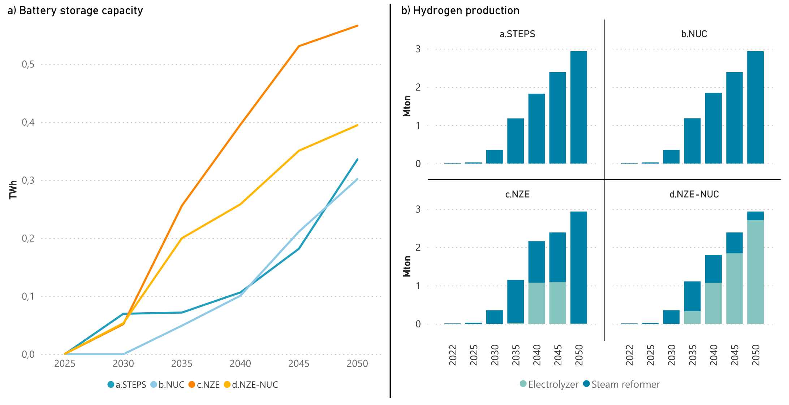

Slide 7
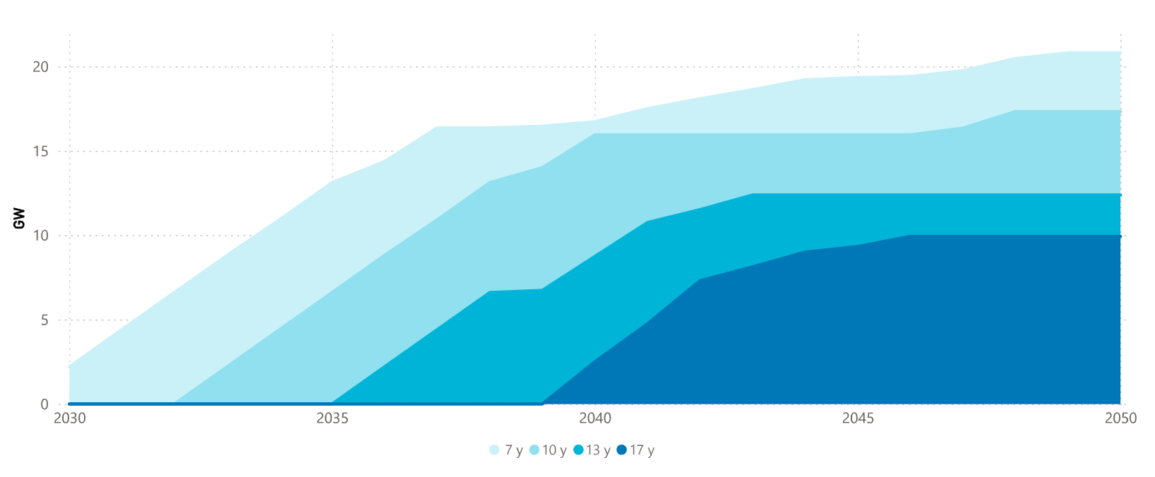
20.8
17.3
12.4
9.9

Slide 8
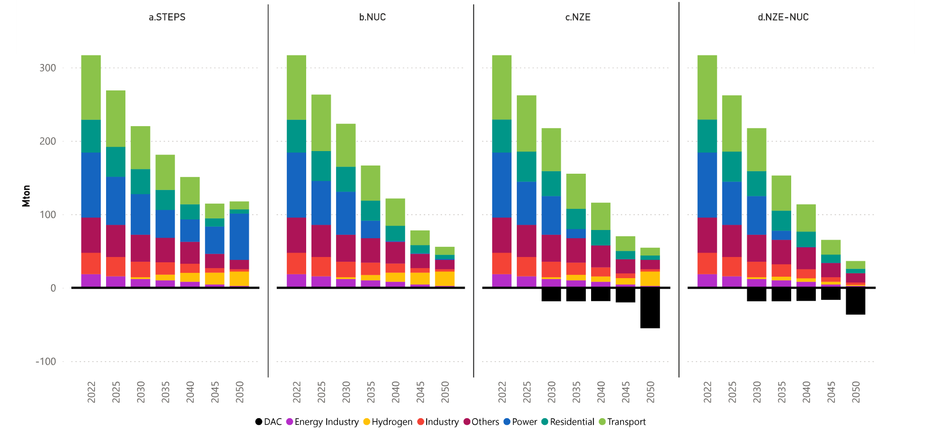

Slide 9
